Slide 1
Microcontroller Based System Design
CSE 3216
Lab 1

Slide 2
Course Teacher:
Afsana Ahmed Munia Assistant Professor, Department of CSE, AUST
Email: afsana.106@gmail.com

Slide 3
What is Arduino?
Arduino is an open-source electronics platform based on easy-to-use hardware and software.
Arduino boards are able to read inputs - light on a sensor, and turn it into an output - activating a motor.
You can tell your board what to do by sending a set of instructions to the microcontroller on the board. To do so you use the Arduino programming language and the Arduino Software (IDE).

Slide 4
Arduino programming language
Arduino programming language can be divided in three main parts: structure, values (variables and constants), and functions.
FUNCTIONS
For controlling the Arduino board and performing computations.
Digital I/O
digitalRead() digitalWrite() pinMode()

Slide 5
digitalRead()
Description
Reads the value from a specified digital pin, either HIGH or LOW.
Syntax
digitalRead(pin)
Parameters
pin: the number of the digital pin you want to read
Returns
HIGH or LOW

Slide 6
digitalWrite()
Description
Write a HIGH or a LOW value to a digital pin.
Syntax
digitalWrite(pin, value)
Parameters
pin: the pin number
value: HIGH or LOW
Returns
Nothing

Slide 7
pinMode()
Description
Configures the specified pin to behave either as an input or an output.
Syntax
pinMode(pin, mode)
Parameters
pin: the number of the pin whose mode you wish to set
mode: INPUT, OUTPUT

Slide 8
STRUCTURE
The elements of Arduino (C++) code.
Sketch loop() setup() | Further Syntax #define (define) #include (include) …………………….
Control Structure break continue do...while ……………… | Arithmetic Operators % (remainder) * (multiplication) + (addition) ………………….....

Slide 9
Bare Minimum
The bare minimum of code needed to start an Arduino sketch.
void setup() {
// put your setup code here, to run once:
}
void loop() {
// put your main code here, to run repeatedly:
}

Slide 10
LED Blink
int ledpin = 12; void setup() { pinMode(ledpin,OUTPUT); } void loop() { digitalWrite(ledpin,HIGH); delay(500); digitalWrite(ledpin,LOW); delay(500); }

Slide 11
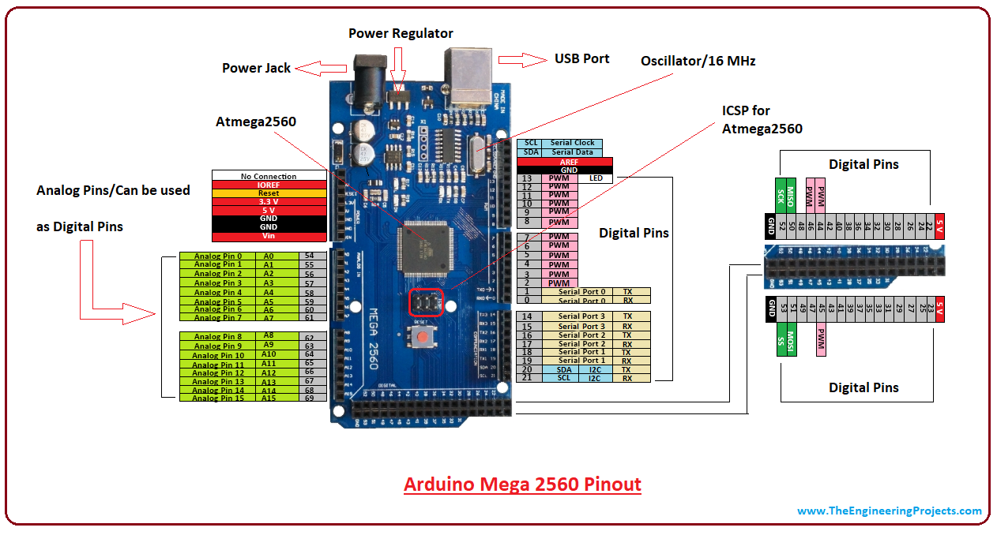

Slide 12
Thank You

